Slide 1
El Clásico de Reddit
Bárça vs. Real Madrid
By Christopher Williams
20 December 2018

Slide 2
Data Science Problem
Use NLP models to predict if certain comments / submissions come from one Subreddit or the other
Subreddit’s
/r/Barca
/r/realmadrid
The Data Collection Process
2834 from Barca
2747 from realmadrid

Slide 3
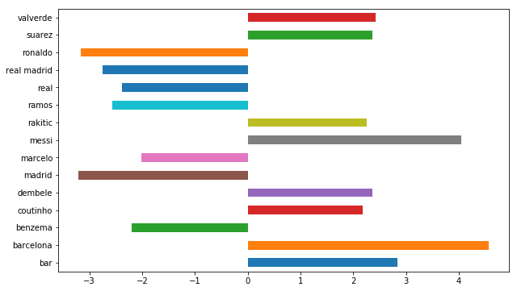
Features with Players / Teams

Slide 4
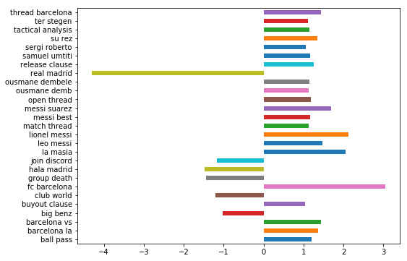
2 grams with Players / Teams

Slide 5
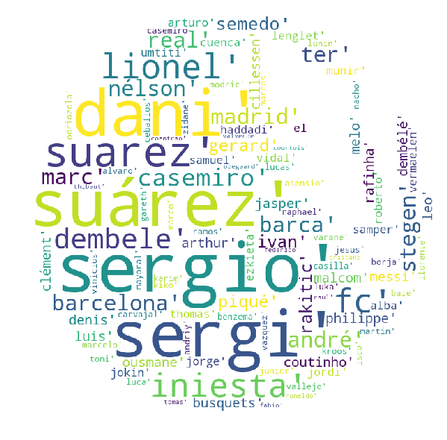
Stop Words:
Took Out Players Names to see performance of models
109 additional stop words along with the sklearn ones

Slide 6
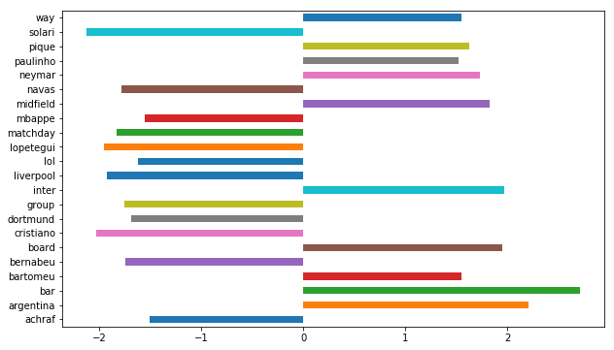
Without Players / Teams

Slide 7
The Models
TfidfVectorizer
LogisticRegression
RandomForestClassifier
ExtraTreesClassifier

Slide 8
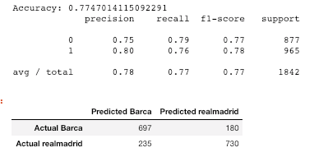
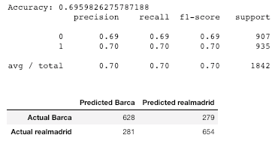
TfidfVectorizer and LogisticReg
TfidfVectorizer - With players names
Tfidf training score 0.926
Tfidf testing score started at 0.696 accuracy
With LogReg in GridSearch with ngrams as (1,3) improved to 0.774 accuracy score
With Players Names Without Names

Slide 9
Forest and Trees
RandomForestClassifier
Best cv scores:
Train: 0.732 without | 0.655 with
Test: 0.699 without |0.608 with
ExtraTreesClassifier
Best cv scores:
Train: 0.743 without|0.664 with
Test: 0.699 without|0.604 with
Without or With Player & Team stop words

Slide 10
Random Forest
With Player’s & Clubs Names
Grid Search CV best score: 0.766
Best Params: {'max_depth': None, 'max_features': 'auto', 'n_estimators': 43}
Without Player’s & Clubs Names
Grid Search CV best score: 0.685
Best Params: {'max_depth': None, 'max_features': 'log2', 'n_estimators': 45}

Slide 11
Conclusions
Top feature is players names
Take the names out, accuracy score drops substantially
Regardless due to the nature of comments being so randomly similar within the two subreddits
To do:
To do more model parameters
More ngram features (3,6)
Put in coaches as stop words

